Slide 1


Slide 2






IEEE BHI 21 Judging Panel
Best Paper Awards
Daniela Giordano
University of Catania, Italy
Elliot Sloane
Villanova University, USA
Maria Fernanda Cabrera
Technical University of Madrid, Spain
Best Poster Awards
Paolo De Carvalho
University of Coimbra, Portugal
Misha Pavel
Northeastern Univrsity, USA

Slide 3
IEEE BHI 2021 Best Poster Award
Dynamic patterns of change in mental health following breast cancer diagnosis: A trajectory-based unsupervised clustering approach
Eugenia Mylona (Unit of Medical Technology and Intelligent Information Systems, University of Ioannina & FORTH-IMBB, Greece); Konstadina Kourou (Institute of Molecular Biology and Biotechnology, FORTH-IMBB, Greece); Georgios C. Manikis (Foundation for Research and Technology, Greece); Evangelos Karademas (University of Crete, Greece); Panagiotis Simos (School of Medicine, University of Crete, Greece); Dimitris Fotiadis (Institute of Molecular Biology and Biotechnology, FORTH, Greece & University of Ioannina, Greece)
3rd Prize

Slide 4
Lisa Yamada, Tomiko Oskotsky and Paul Nuyujukian (Stanford University, USA)
IEEE BHI 2021 Best Poster Award
Seizure detection using human intracranial electrophysiology via information theoretic methods
Lisa Yamada, Tomiko Oskotsky and Paul Nuyujukian (Stanford University, USA)
2nd Prize

Slide 5
IEEE BHI 2021 Best Poster Award
A Study on Potential Frequency Domain Indicators for STEMI Diagnosis Using Ultra-Short-Term ECG Signals
Ting Xiang and Nan Ji (City University of Hong Kong, Hong Kong); Yuanting Zhang (Hong Kong Centre for Cerebro-Cardiovascular Health Engineering (COCHE), Hong Kong)
1st Prize

Slide 6
IEEE BHI 2021 Best Paper Award
Transcutaneous Cervical Vagus Nerve Stimulation Lengthens Exhalation in the Context of Traumatic Stress
Authors: Asim H Gazi; Srirakshaa Sundararaj; Anna Harrison; Nil Gurel; Matthew Wittbrodt; Amit J Shah; Viola Vaccarino; Douglas Bremner; Omer T Inan
3rd Prize

Slide 7
IEEE BHI 2021 Best Paper Award
Utility of High-Throughput Imaging Mass Cytometry for Cancer Research: A feasibility study
Authors: Sindhura Thirumal; Amoon Jamzad; Tiziana Cotechini; Charles T. Hindmarch; Céline Hardy; Charles Graham; David Berman; Robert Siemens; Parvin Mousavi
2nd Prize

Slide 8
IEEE BHI 2021 Best Paper Award
HistoTransfer: Understanding Transfer Learning for Histopathology
Authors: Yash Sharma; Lubaina Ehsan; Sana Syed; Donald Brown
1st Prize

Slide 9
IEEE BSN 21 Judging Panel
Best Paper Awards
Karl Friedl
US Army Res Inst of Environ Med, USA
Carmen Poon
Chinese University of Hong Kong
Ye Li
Shenzhen Inst Advanced Tech, China
Best Poster Awards
Federico Parisi
Harvard Medical School, USA
Valeria De Luca
Novartis, Switzerland
Reed Hoyt
US Army Res Inst of Environ Med, USA

Slide 10
IEEE BSN 2021 Best Poster Award
Oil membrane protected sensor – a key breakthrough for continuous biosensing
Yuchan Yuan, Madeline DeBrosse, and Jason Heikenfeld
University of Cincinnati, USA
3rd Prize

Slide 11
IEEE BSN 2021 Best Poster Award
Classification of postures with clothing-mounted wearable sensors
Udeni Jayasinghe, Balazs Janko, William S. Harwin, and Faustina Hwang
University of Reading, Great Britain
2nd Prize

Slide 12
IEEE BSN 2021 Best Poster Award
A pilot study using covert visuospatial attention as an EEG-based brain computer interface to enhance AR interaction
Nataliya Kosmyna
MIT Media Lab, Boston, USA
1st Prize

Slide 13
IEEE BSN 2021 Best Paper Award
Identifying causal relationships in time-series data from a pair of wearable sensors
D.K. Arvind, S. Maiya, and P. Andreu Sedeno
Centre for Speckled Computing, University of Edinburgh, Scotland
3rd Prize

Slide 14
IEEE BSN 2021 Best Paper Award
Wireless respiration monitoring using a flexible sensor and bistable circuit
Zhipeng Li, Ze Xiong, Chenhui Li, and John S. Ho
National University of Singapore, Singapore
2nd Prize

Slide 15
IEEE BSN 2021 Best Paper Award
Artificial ear – a wearable device for the hearing impaired
Antonia Pavilidou and Benny Lo
Imperial College, London, Great Britain
1st Prize

Slide 16



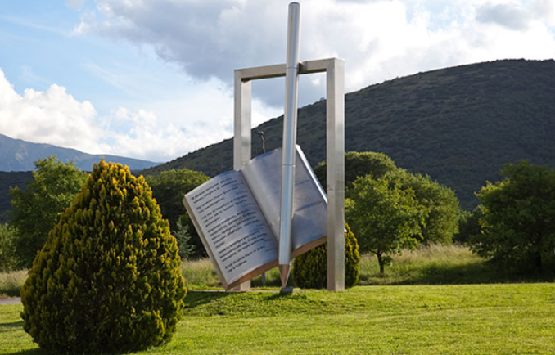





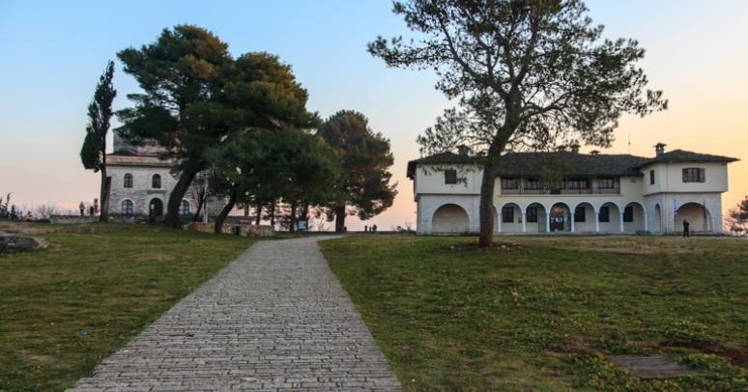


You are welcome to attend
IEEE BHI - BSN 2022
Ioannina, Greece, October 2022

